Slide 1
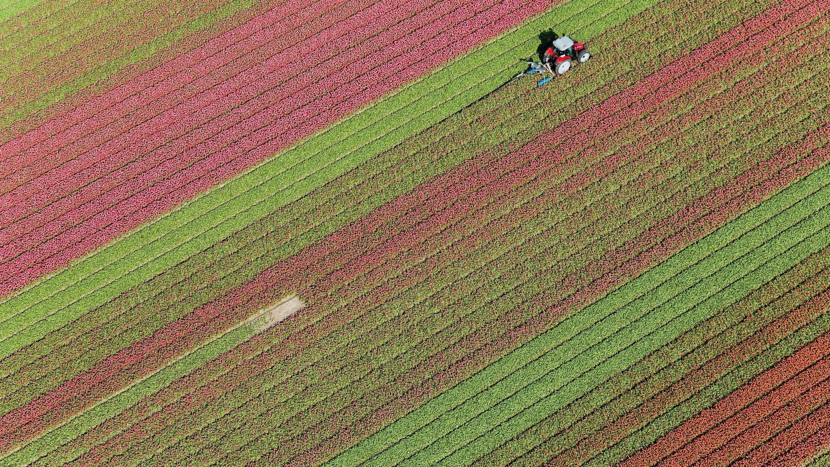
DishDash: A Discount-Driven Online Ordering Platform
-Siddaharth Suman and Ketaki Suhas Kulkarni
ITC 6355: Web Application Design and Development
Prof. Amin Karimpour

Slide 2
Agenda
Project Description
Objectives
Scope of the Project
Features Overview
Ordering & Tracking Features
Discount & Reward System
Technology Stack
Market Research

Slide 3
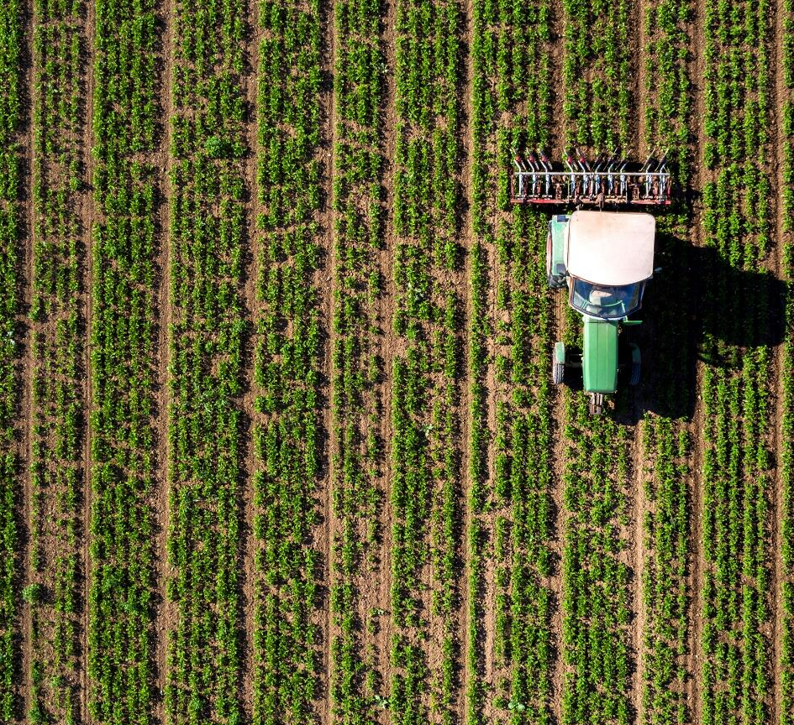
Project Description
What is DishDash?
A web-based platform connecting small and medium-sized restaurants to customers.
Offers a $1 discount on every order to incentivize usage.
Key Benefits:
Enhances online visibility for restaurants.
Simplifies the online ordering process.
Encourages repeat orders and higher sales volumes.

Slide 4
Objectives
Enhance Restaurant Visibility
Increase brand awareness and customer retention.
Promote Higher Order Volumes
$1 discount per order and volume-based discounts.
Simplify Online Ordering
User-friendly interface with features like order history and saved payments.

Slide 5
Scope of the Project
Scalable for various restaurant types (fast food to fine dining).
Initial phase: Onboard local restaurants and refine user experience.
Key Features:
User Account Management
Restaurant Listings
Order Tracking
Discount & Reward System

Slide 6
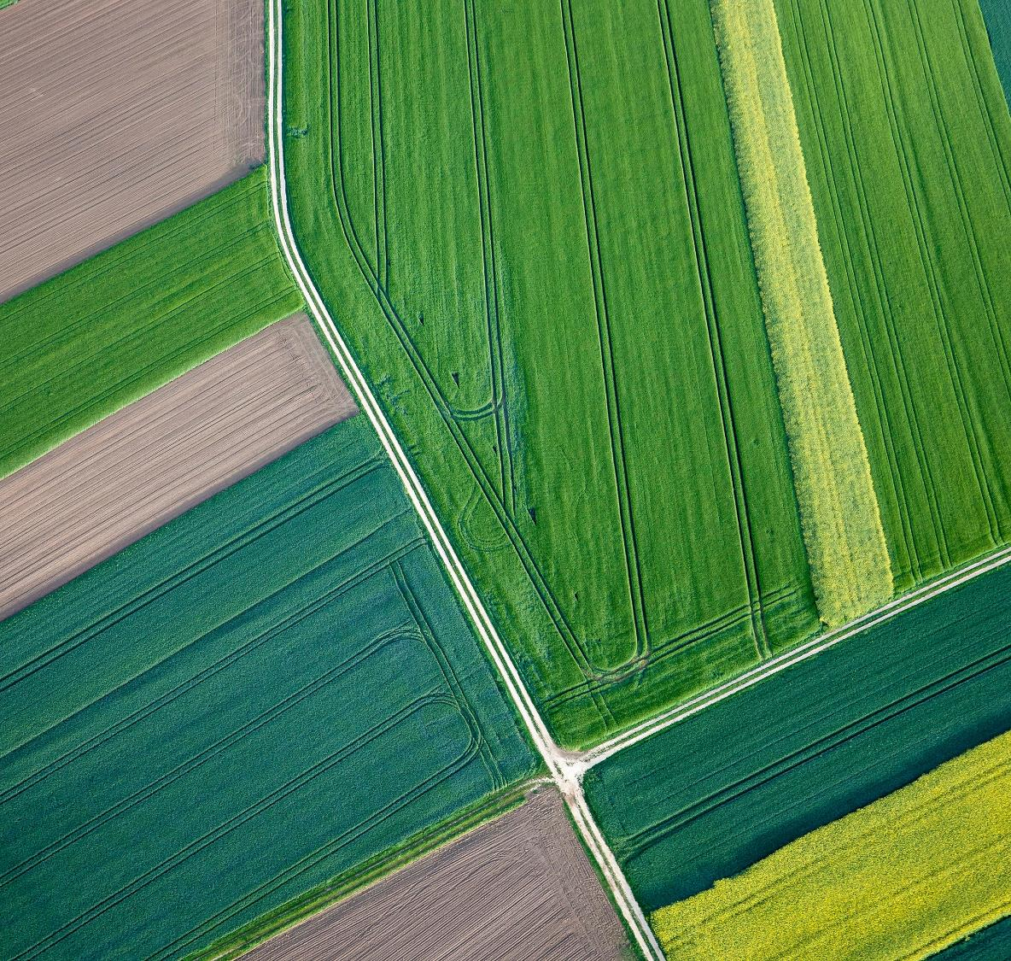
Features Overview
User Account Management:
Secure registration and login.
Personalized profiles and saved order history.
Restaurant Listings:
Filterable options by cuisine, ratings, and more.
Real-time menu updates.
Customer reviews and ratings.

Slide 7
Ordering and Tracking Features
Ordering Process:
Intuitive menu selection and customization.
Real-time Tracking:
Status updates like "Preparing" and "Out for Delivery."
Push Notifications:
Order updates, delivery times, and promotions.

Slide 8

Discount and Reward System
$1 discount on every order.
Loyalty points redeemable for discounts.
Volume-based discounts for bulk orders.

Slide 9
Technology Stack
Frontend: React.js Backend: Node.js & Express.js Database: MongoDB Authentication: Firebase Payments: Stripe Hosting: AWS

Slide 10

Market Research
Competitive Landscape:
Competing with GrubHub, DoorDash, and UberEats.
DishDash Differentiation:
Focus on small and medium-sized businesses.
Affordable and customer-friendly platform.
Incentives for frequent usage.

Slide 11
Thank You

